Slide 1



HealthSync
Patient Appointment and Management System with Real-Time Analysis
D23CS102-Siddhit Kale
D23CS104-Denis Ruparel
D23CS108-Tanay Mahale
Under the Guidance of: Asst.Prof. Dr.Jigar Sarda

Slide 2


Workdone

Slide 3


Work completed until now.
Login (Onboarding Page)

Slide 4

Work completed until now.
Validation of Login Page

Slide 5
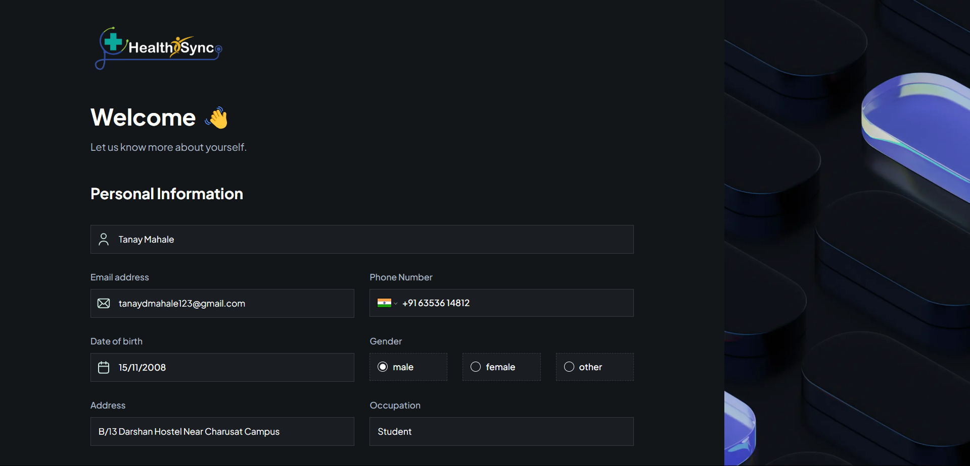
Work completed until now.
Personal Information Form

Slide 6
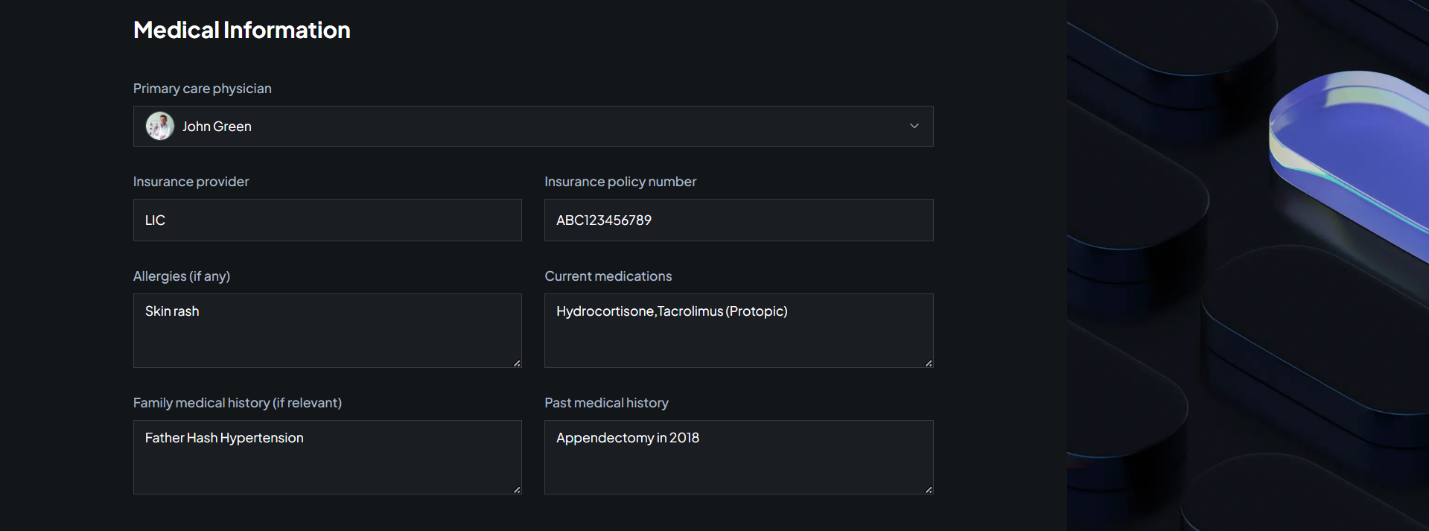
Work completed until now.
Medical Information Form

Slide 7
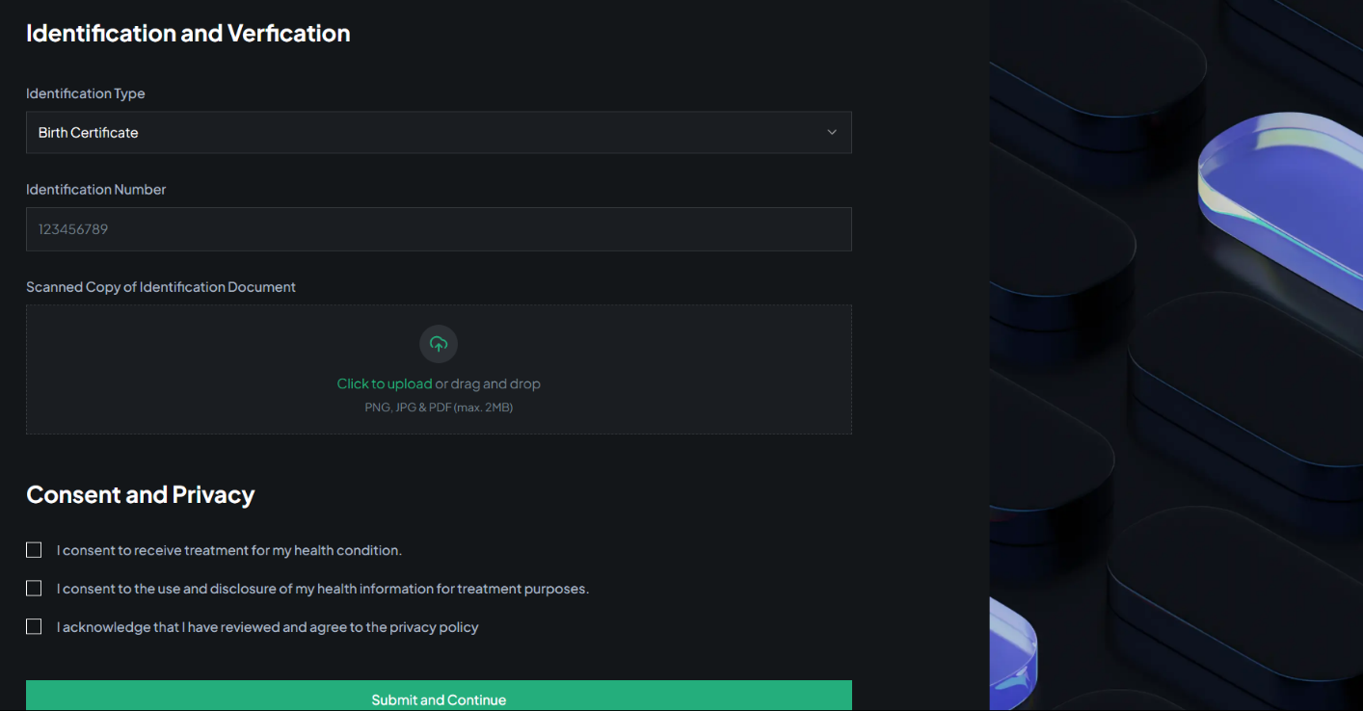
Work completed until now.
Identification and Verification

Slide 8
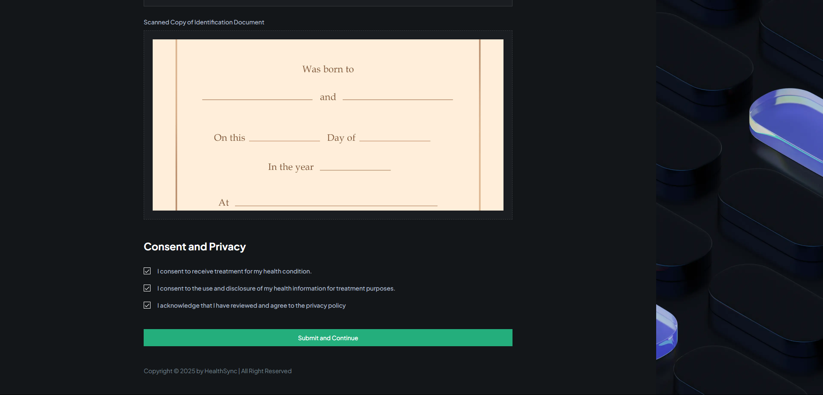
Work completed until now.
Identification and Verification

Slide 9
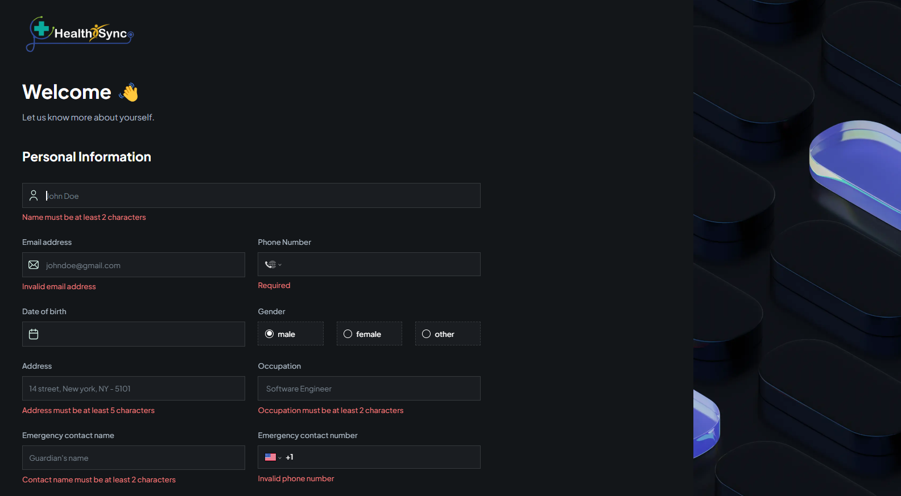
Work completed until now.
Validations

Slide 10
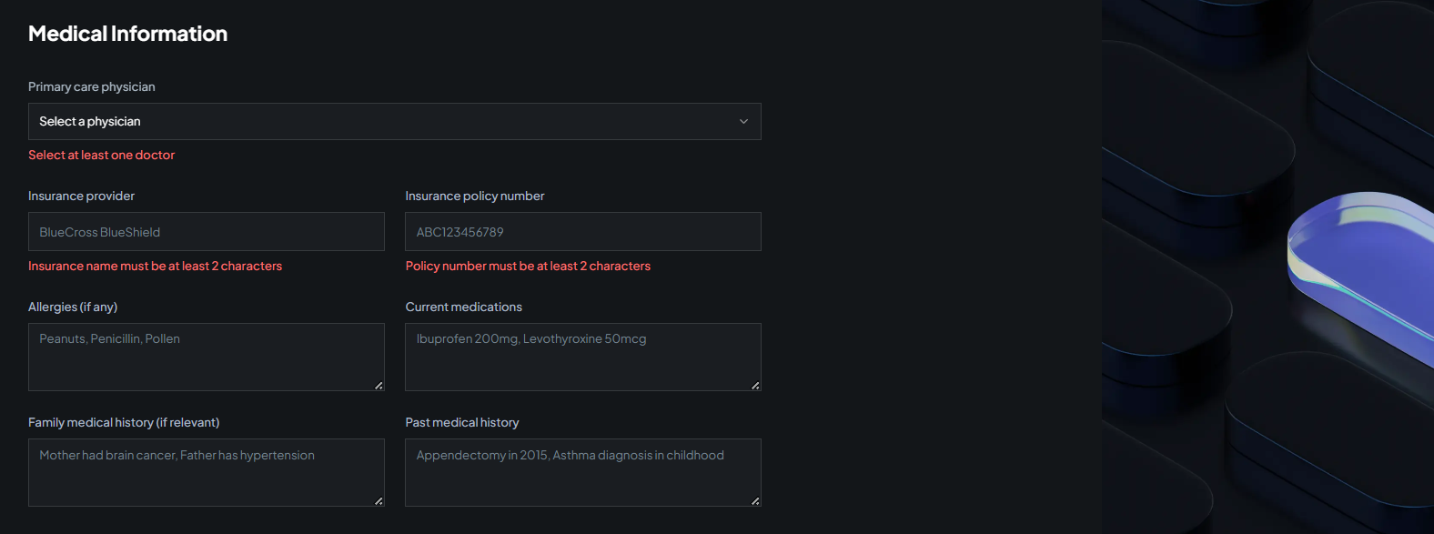
Work completed until now.
Validations

Slide 11
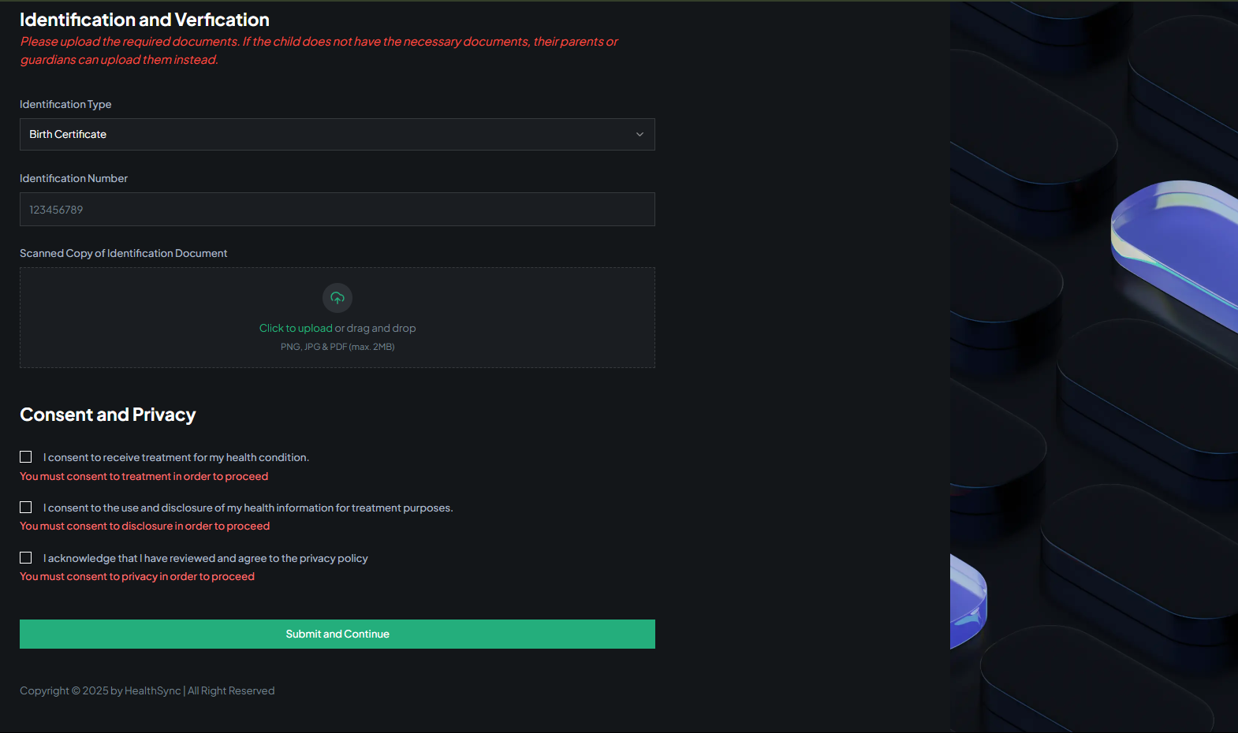
Work completed until now.
Validations

Slide 12
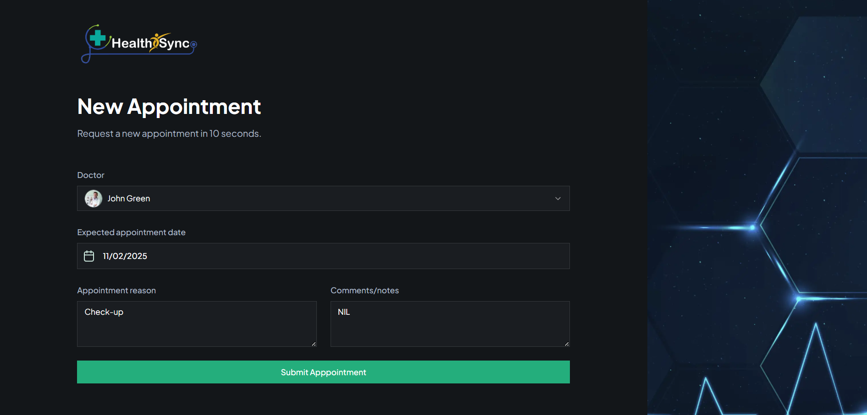
Work completed until now.
Appointment Booking Form

Slide 13
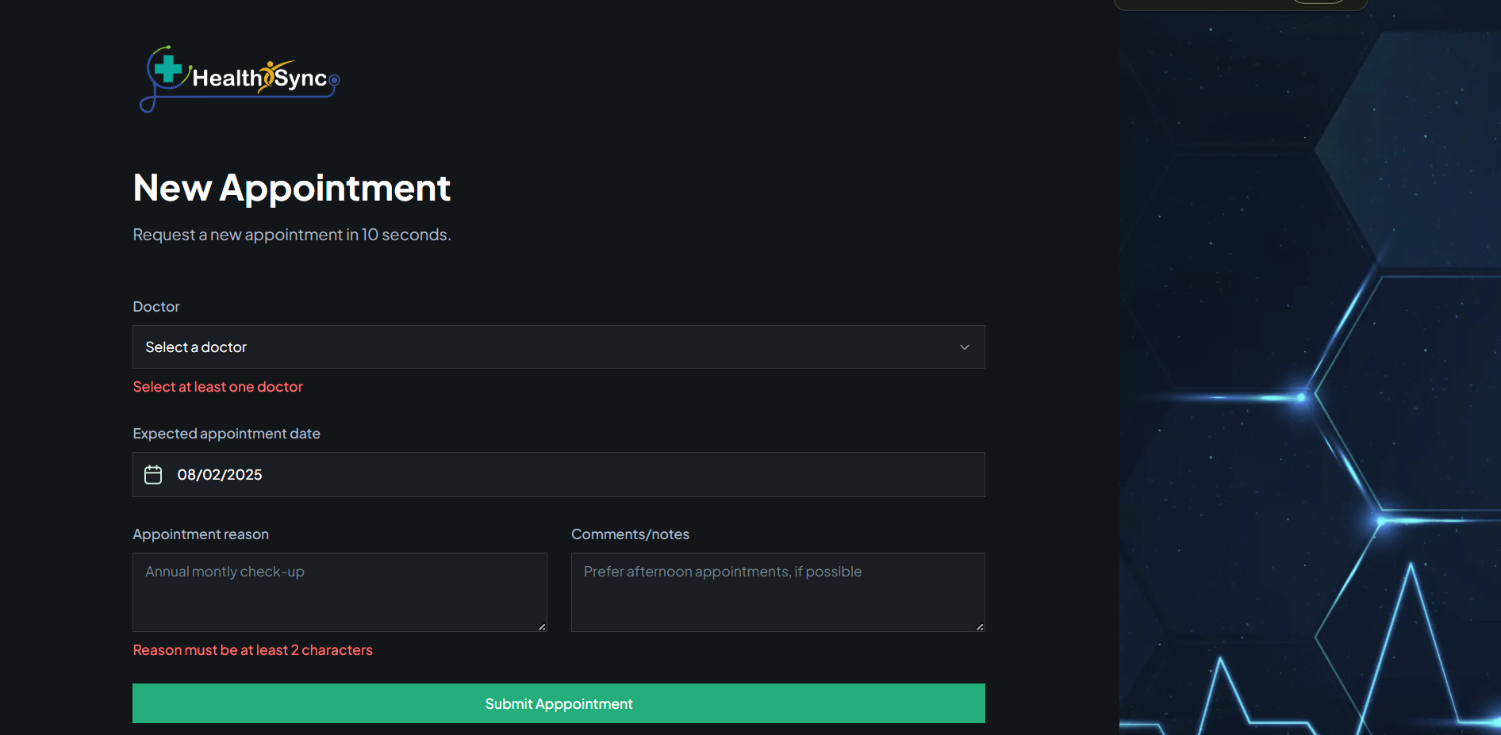
Work completed until now.
Appointment Booking Form (Validations)

Slide 14
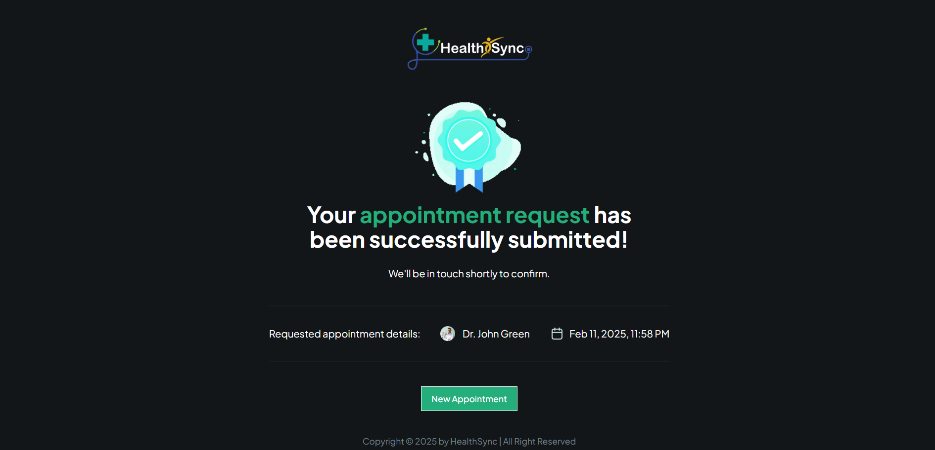
Work completed until now.
Successfully Your Appointment Book

Slide 15

Upcoming Weeks Plan
Notification Feature
Admin Panel
Deployment
Power-Bi Report

Slide 16


Slide 17
HealthSync
Patient Appointment and Management System with Real-Time Analysis
D23CS102-Siddhit Kale
D23CS104-Denis Ruparel
D23CS108-Tanay Mahale
Under the Guidance of: Asst.Prof. Dr.Jigar Sarda
Github: https://github.com/DenisRuparel/HealthSync

